Slide 1
Final Project: Enhanced Indexing Strategy
with Multi-Factor Model
Presented by Group 4
Jiahua Jiang, Bo Sun, Baowen Cao

Slide 2
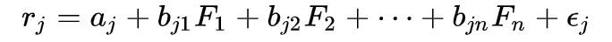
Project
Introduction
In this project, we built up an Enhanced Indexing Strategy of China Securities Index (CSI) 500 on the basis of Arbitrage Pricing Theory (APT), by applying the Multi-Factor Model with regression method to predict the expected return of CSI 500 constituent stocks and determining the active weights in accord with our prediction.
2

Slide 3
Outlines
Collect and Preprocess Data
Preprocess Factors
Factor Modeling and Strategy Construction
Backtesting
3

Slide 4
Collect and Preprocess Data
/01
4

Slide 5
1. Collect and Preprocess Data
Get current CSI 500 constituent stocks and weights from Wind (csi_500_constituent_info.gz)
Get monthly price and factor information of 500 constituent stocks from 2015-01-01 to 2019-04-26 (csi_500_data_raw.gz)
- Size: Market Capitalization
- Value: P/E, P/B, P/S, P/CF, EV/EBITDA
- Profitability: ROE, ROIC, Net Profit Margin
- Growth: Year-over-Year Net Income Growth Rate, Year-over-Year Revenue Growth Rate
- Trading: Turnover Rate
Preprocess data (csi_500_data_preprocessed.gz)
- Fill nans with data of the nearest month
- Check if there're any nans left and locate them
- EV/EBITDA and ROIC of 10 companies in banking and non-bank financial industries are missing
- Fill nans remaining with industry's average

Slide 6
Preprocess Factors
/02
6

Slide 7
2. Preprocess Factors
Calculate next month's return as dependent variable for future regression
Winsorize, standardize and neutralize factor values (factor_data.gz)
- Winsorize: Trim the outliers at the tail (2.5 percentile) to avoid anomalies
- Standardize: Convert factor values into z-scores to eliminate discrepancies in number scale
- Neutralize: Eliminate the impact of industrial betas to avoid concentration of our stock selection model, by extracting residual in multiple linear regression between factor value and dummy variables of industries

Slide 8
Factor Modeling and Strategy Construction
/03
8

Slide 9
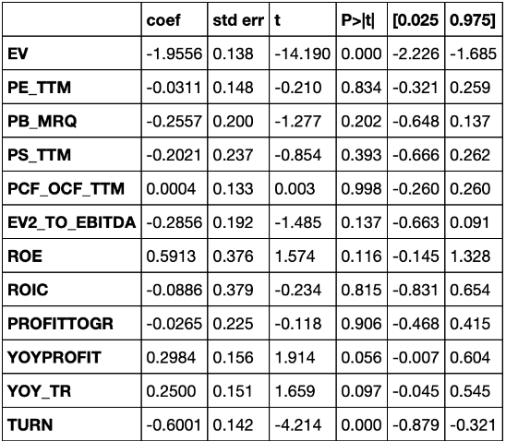
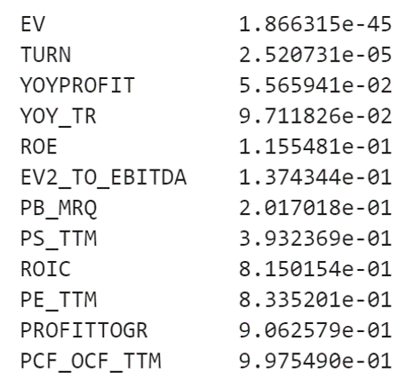
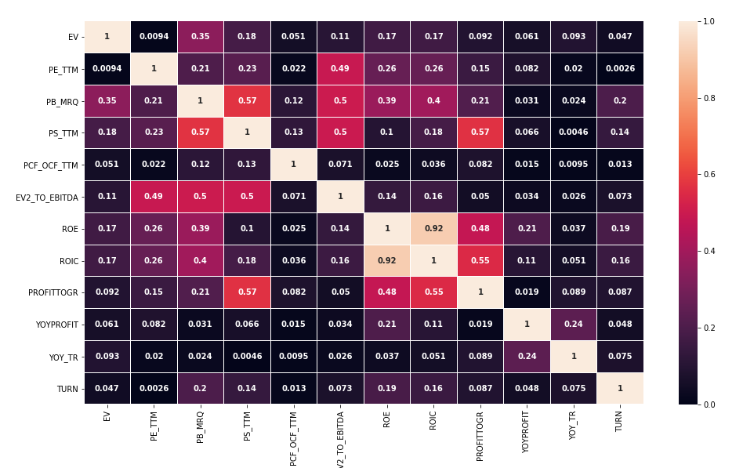
3. Factor Modeling and Strategy Construction
Separate the data into training and testing
- Training data: 2015-01-01 to 2017-12-31
- Testing Data: 2018-01-01 to 2019-04-26
Multiple linear regression (OLS) between next month's return and factor values
Improve the regression model
- Sort the p-values to check the significance level of each factor's exposure (slope coefficient)
- Plot a heatmap of the correlation matrix of factors to tell if there's multicollinearity

Slide 10
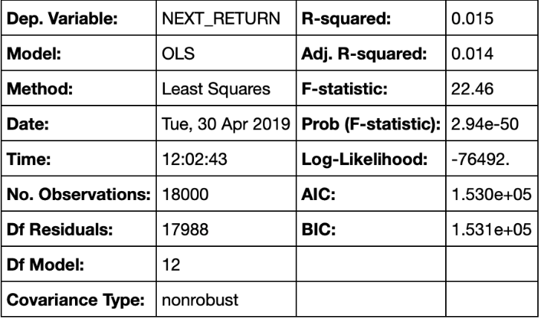


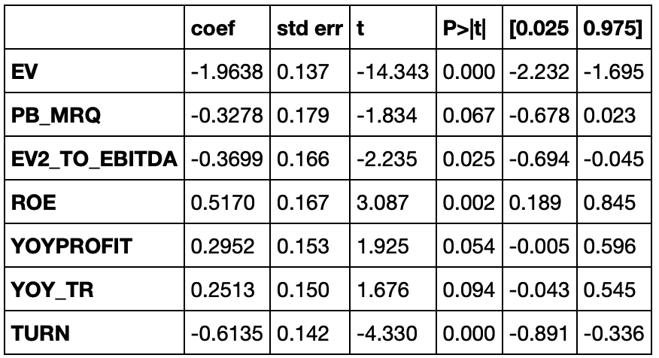
3. Factor Modeling and Strategy Construction
3. Improve the regression model
- Remove redundant factors of high correlation with other factors and high p-values (low significance level)
- Factor remaining: "EV", "PB_MRQ", "EV2_TO_EBITDA", "ROE", "YOYPROFIT", "YOY_TR", "TURN"
- Rerun multiple linear regression and compare the results

Slide 11
3. Factor Modeling and Strategy Construction
Build up an enhanced indexing strategy on the basis of model prediction
- Clearing all positions and opening new positions at the end of each month
- Using the multi-factor model to generate the score (prediction of expected return) of each constituent stock
- Sort the constituent stocks by their scores and separate them into 10 groups
- Set a multiplier for each group to put more weight on high-score stocks and vice versa
- Clean up if there's still weight remaining
- Evenly separated into 10 parts to buy top 10 stocks
- Record the weighted return

Slide 12
Backtesting
/04
12

Slide 13
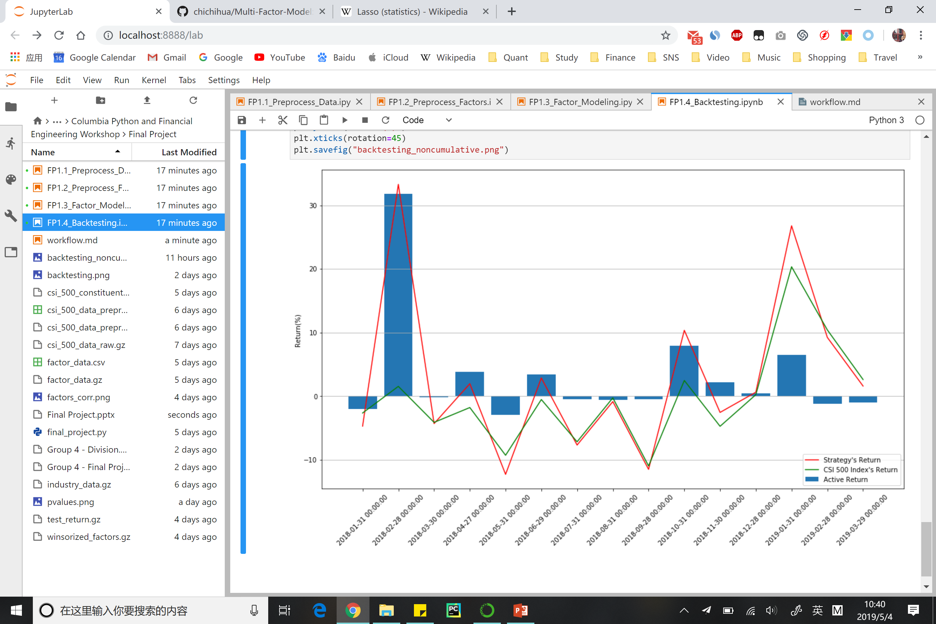
4. Backtesting
Get CSI 500 price information from Tushare
Check the active return: compare the return of the index and our enhanced indexing strategy
- Active return = portfolio return (strategy’s return) – benchmark return (CSI 500 return)
3. Performance evaluation
Noncumulative Monthly Return
Cumulative Monthly Return

Slide 14
Summary
* Benefits:
- The enhanced indexing strategy outperforms the benchmark index to a considerable extent in 7 among 15 months, and has low drawbacks the month it performs worse than the benchmark
- The model is meaningful on both statistical and economic aspects given the predictions are made on the basis of different catogories of factors
- Since CSI 500 has a large sample size and the testing period is long, the multi-factor model tends to be more effective
- Algorithmic model can be better than subjective judgment when dealing with stock selection in a large stock pool such as CSI 500
14

Slide 15
Summary
* Limitations:
- The model ignores trading cost which will narrower the active return
- The model ignores free-float market capitalization which may lead to problems in stock trading
- The model ignores specific investment amount when using 1 as total weight, not taking liquidity need and market impact in consideration
- The OLS method might not be optimal given it has a low r-squared and the process of removing redundant factors is subjective, though the slope coefficients are significant, using LASSO (Least Absolute Shrinkage and Selection Operator) instead might be better
- The effectiveness of the model might be changing over time
15

Slide 16
Thanks for Watching
Jiahua Jiang
Bo Sun
Baowen Cao

